Slide 1
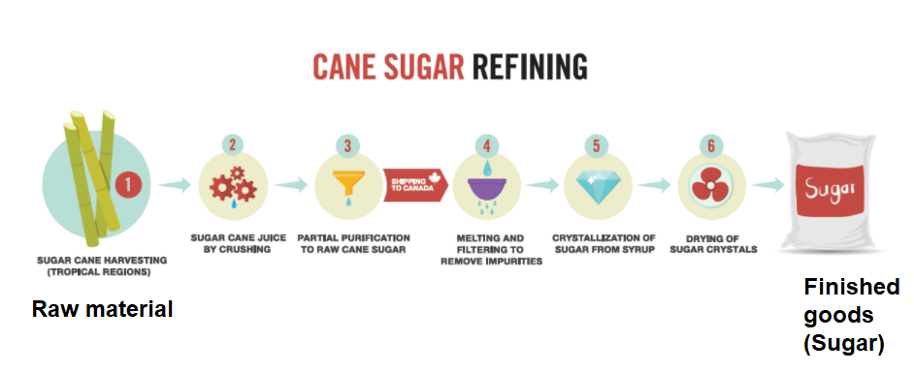
Production
Production is the process by which raw materials and other inputs are converted into finished products is known as Production.
Production Management is the process of planning, organizing, directing and controlling the activities of production function is known as Production Management.

Slide 2
Objectives of Production Management
Ultimate/Main Objectives
Intermediate Objectives
Machinery and Equipment
Materials management
Manpower allocation
Manufacturing services
Right Quality
Right Quantity
Right Time
Ultimate objectives are used to produce goods and services

Slide 3
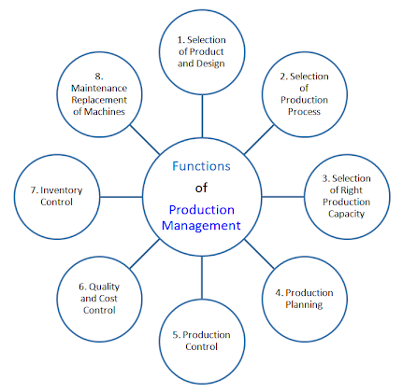

Slide 4

Amazon.com, Inc, is an American multinational technology company based in Seattle, Washington, which focuses on e-commerce, cloud computing and artificial intelligence.
It is considered one of the Big Five companies in the U.S. information technology industry, along with Google, Apple, Microsoft, and Facebook.

Slide 5
Retail is the process of selling consumer goods or services to customers through multiple channels of distribution to earn a profit. OR
A retailer is a company that buys products from a manufacturer or wholesaler and sells them to end users or customers.
Virtual retail is retailing on the Internet.
Many traditional retailers are entering the virtual retail market in support of their physical stores.
Warehouse is a building for storing goods.
Warehouse is “a planned space for the efficient storage and handling of goods and materials.

Slide 6
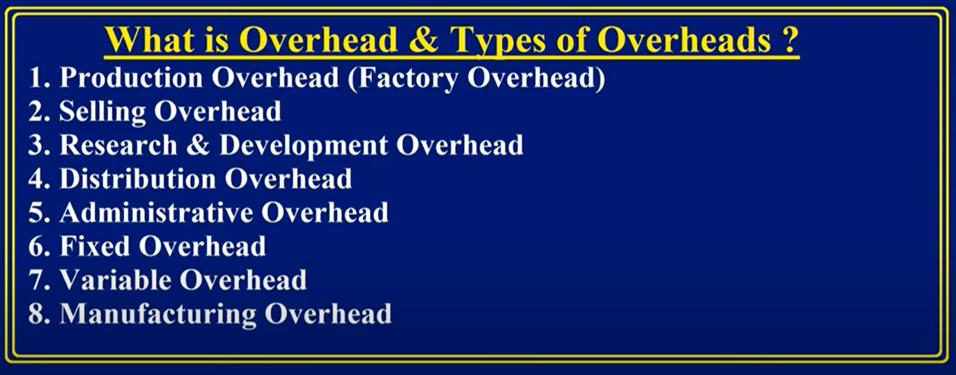













Overhead refers to the ongoing business expenses not directly attributed to creating a product or service

Slide 7
Inventory
Inventory or stock is the goods and materials that a business holds for the goal of resale.
Inventory refers to all the items, goods, merchandise, and materials held by a business for selling in the market to earn a profit.

Slide 8
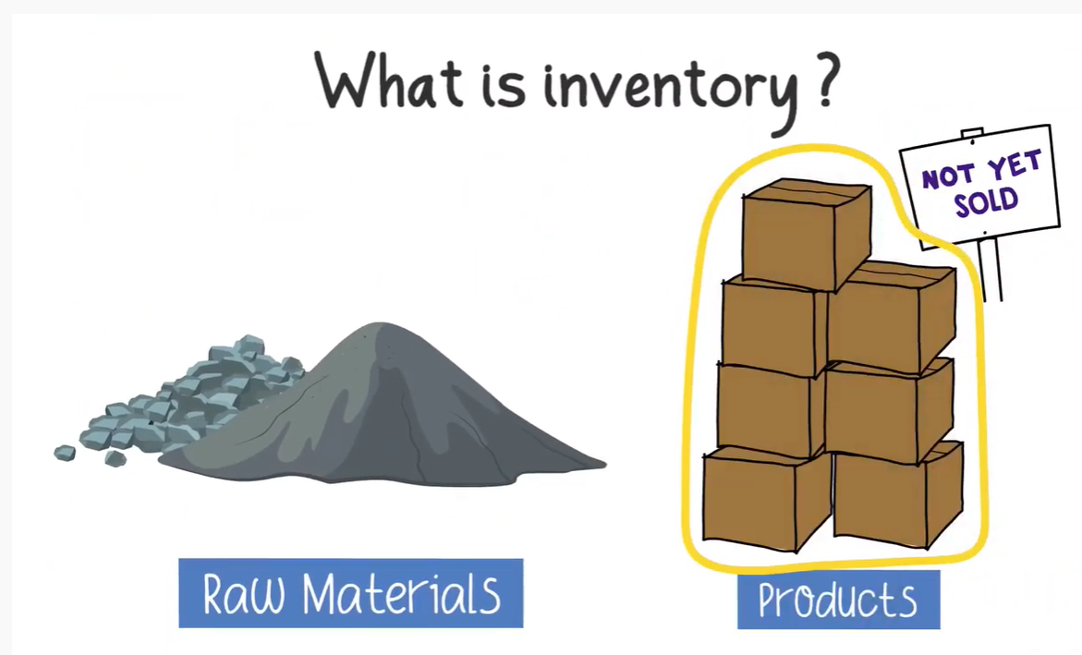

Slide 9
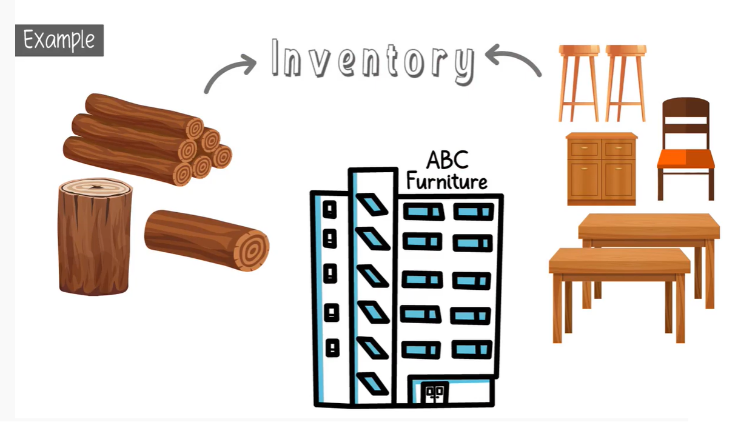

Slide 10
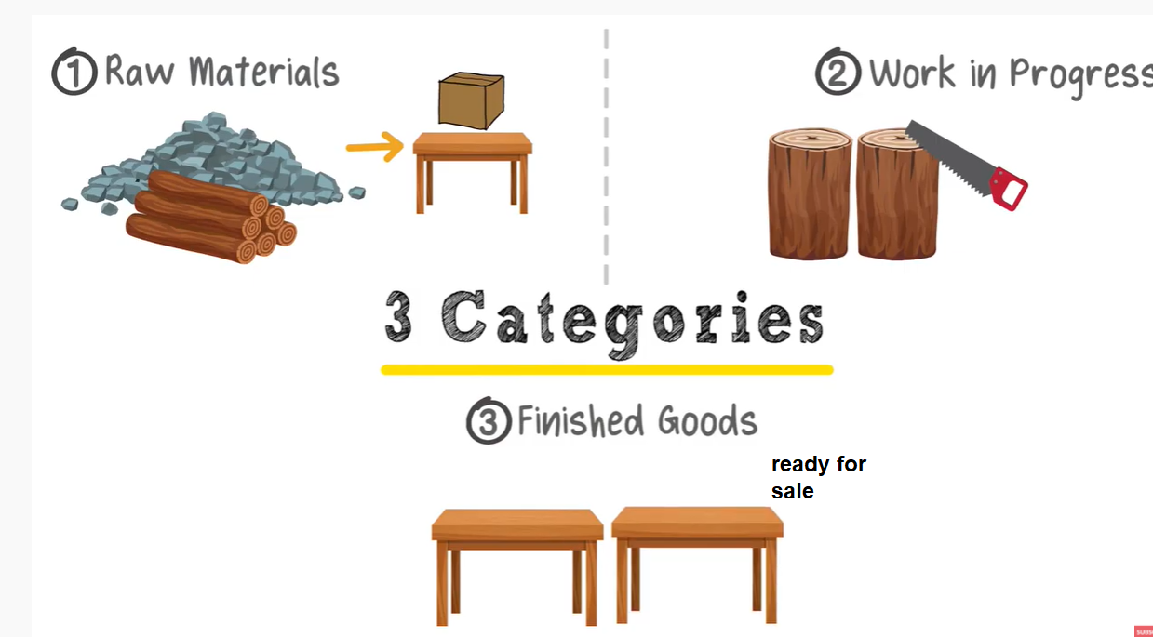
Three Categories of Inventory

Slide 11

















































Slide 12
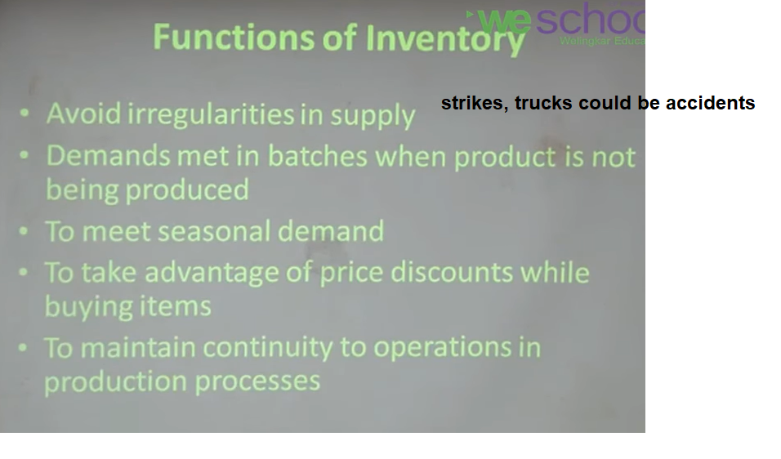

Slide 13
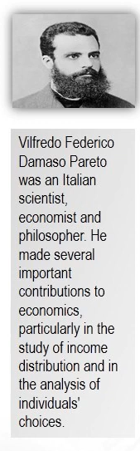
ABC Analysis
ABC analysis is a management tool.
ABC analysis also known as always better plan.
ABC analysis is an approach for classifying inventory items based on the items consumption values.
ABC analysis is based on Pareto principle which also referred to as the 80/20 rule where 80 percent of the output is determined by 20 percent of the input.

Slide 14
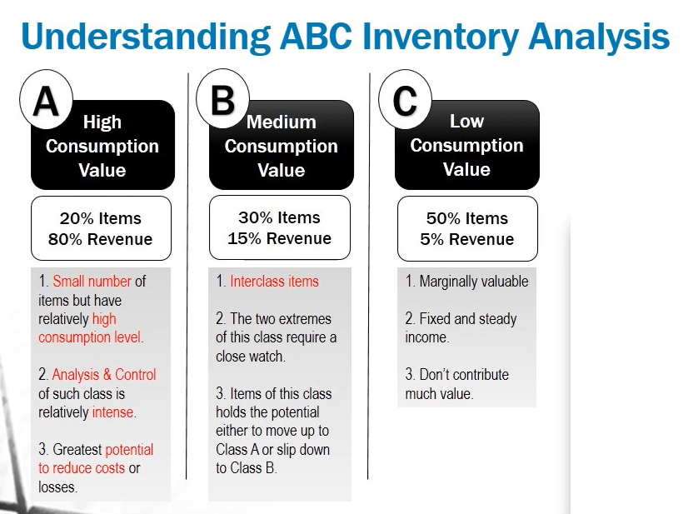
ABC Analysis Classification
In ABC analysis we can divide into 3 categories like A, B and C

Slide 15
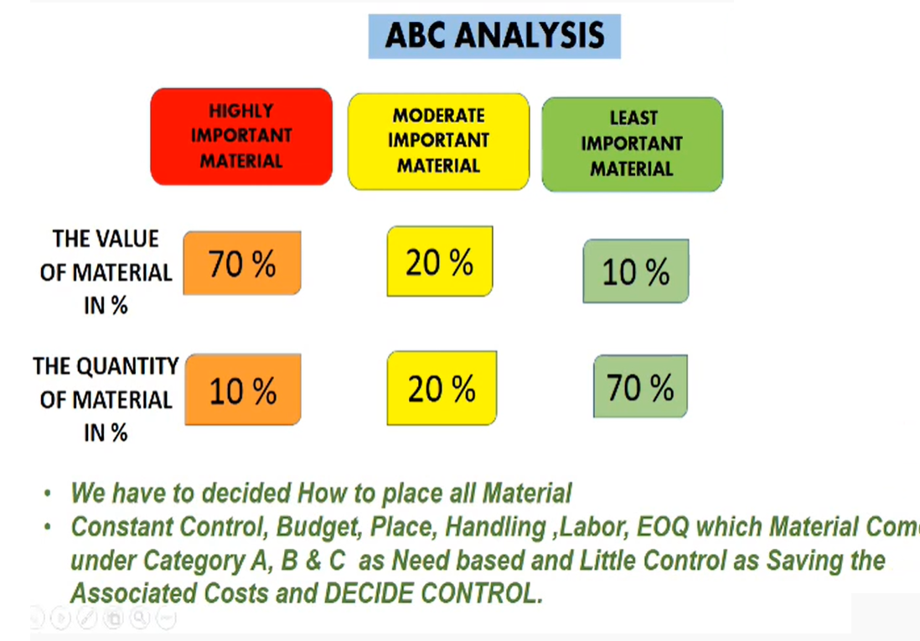

Slide 16
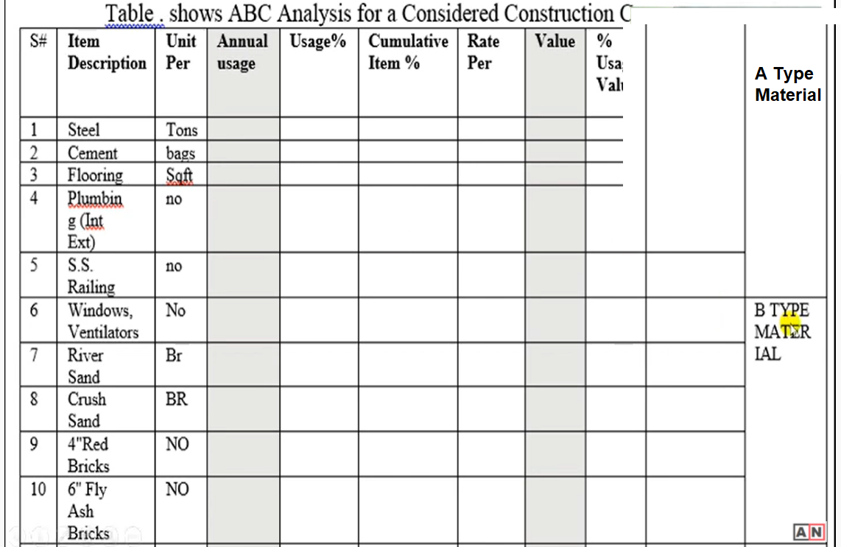

Slide 17
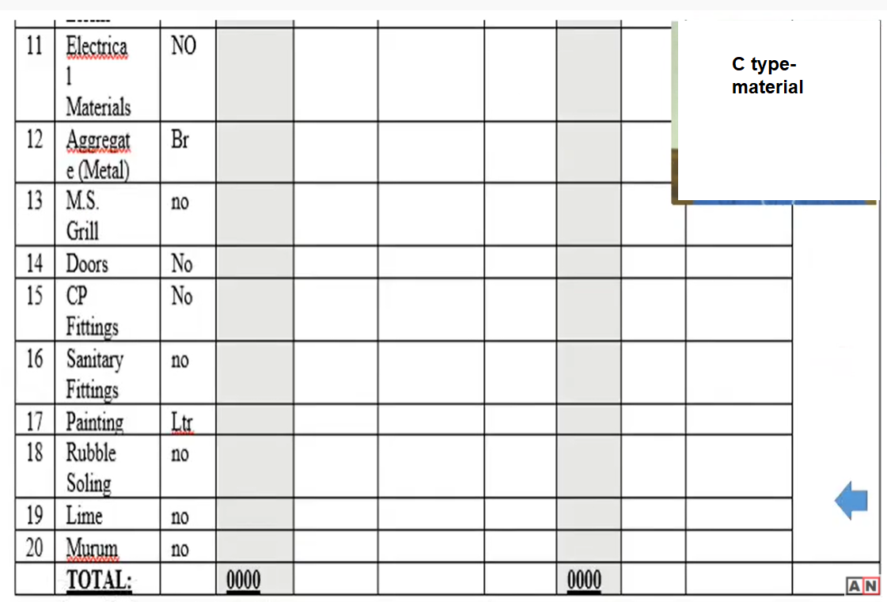

Slide 18
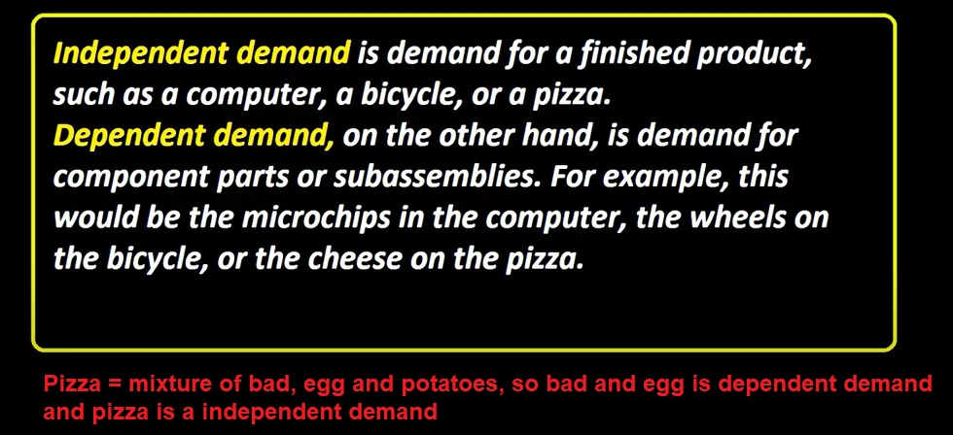

Slide 19
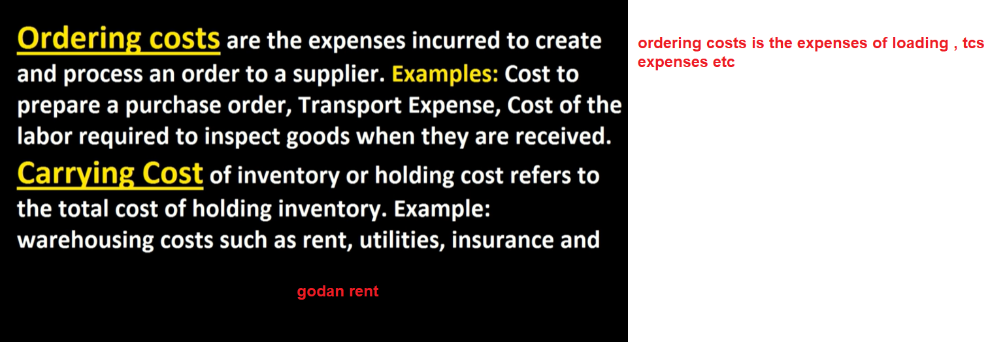

Slide 20
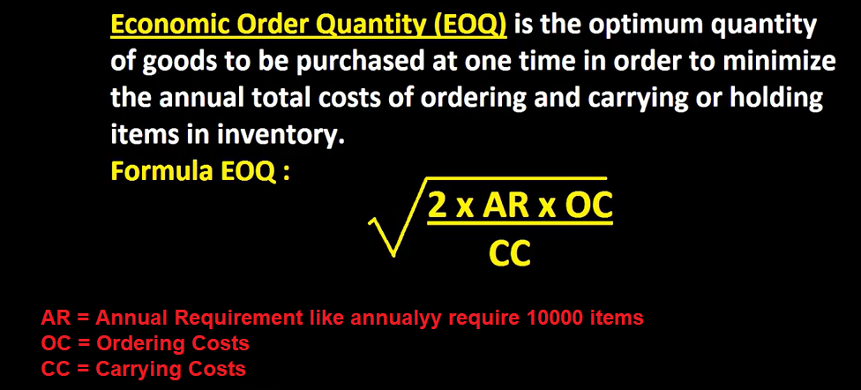

Slide 21
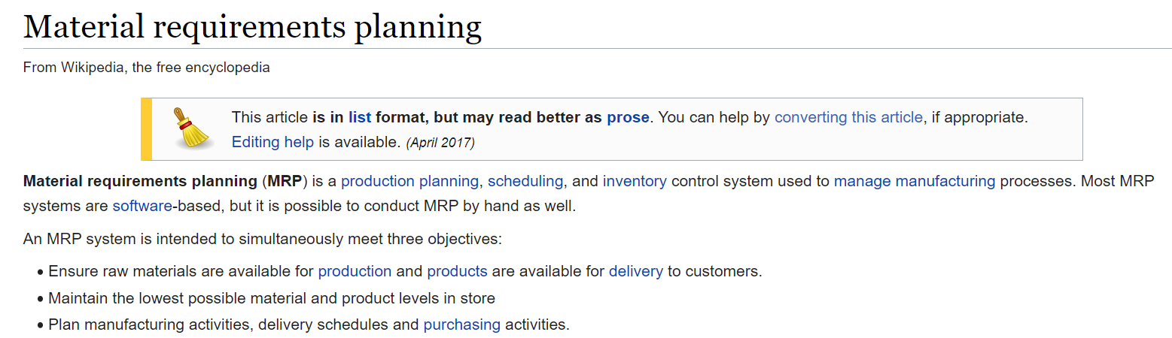

Slide 22
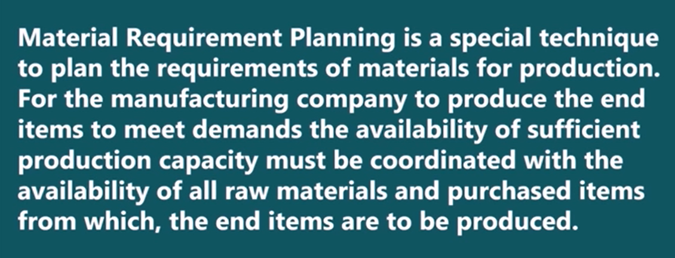
MRP (Material Requirement Planning)

Slide 23
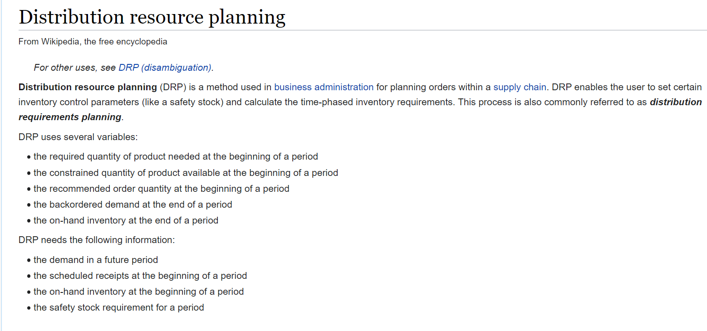

Slide 24
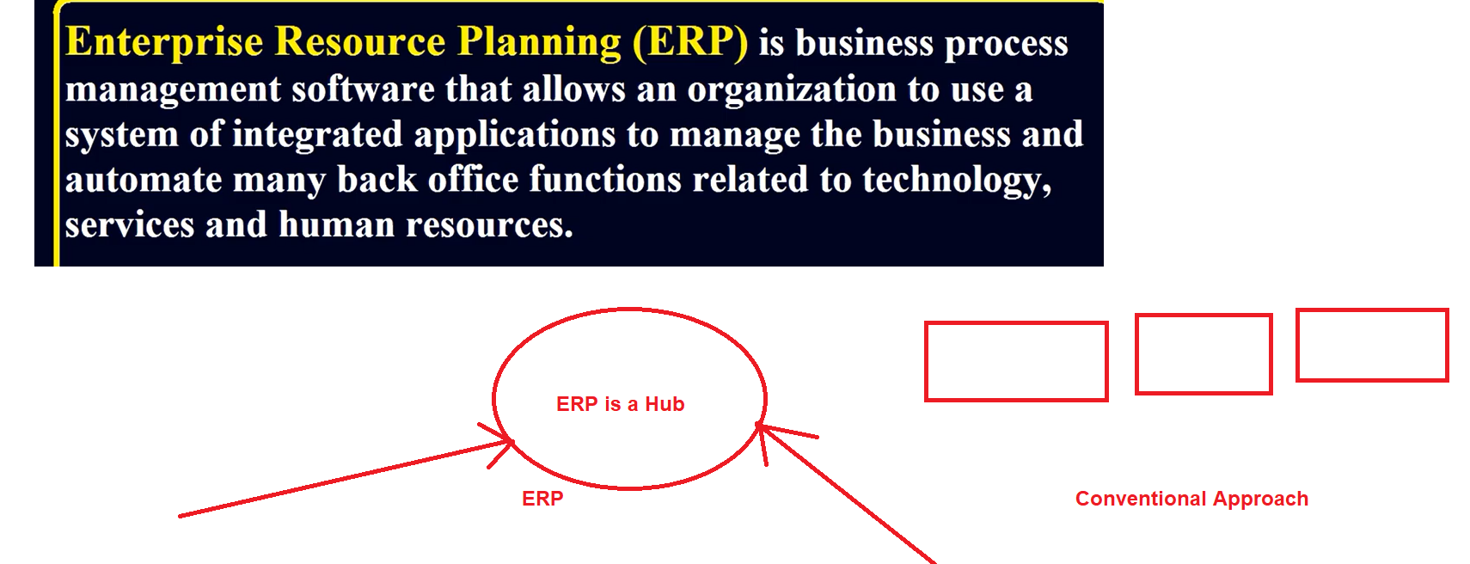

Slide 25


















































4 types of costs are related with inventory cost

Slide 26



















Slide 27







































Purchasing costs are the costs of goods acquired from suppliers including transportation cost

Slide 28





























































































This includes warehousing costs such as rent, utilities and salaries, financial costs such as opportunity cost, and inventory costs related to perishability, shrinkage (leakage) and insurance
Holding cost = carring cost

Slide 29
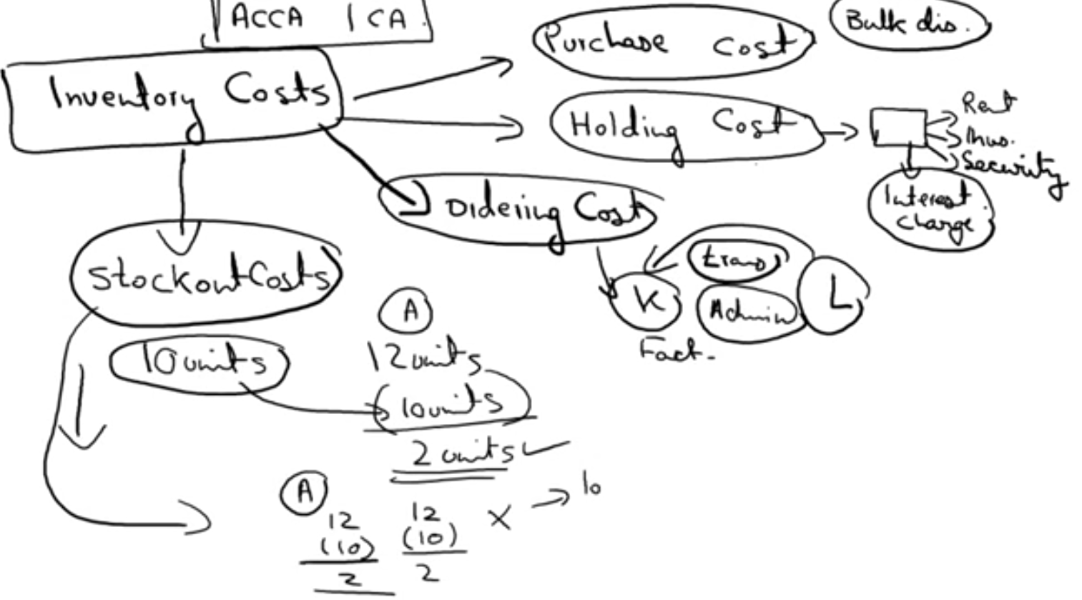





Slide 30


































































Ordering cost is also called as set-up cost

Slide 31
























































Stockout cost = storage cost
Stockout cost is the lost income and expense associated with a shortage of inventory.

Slide 32

















































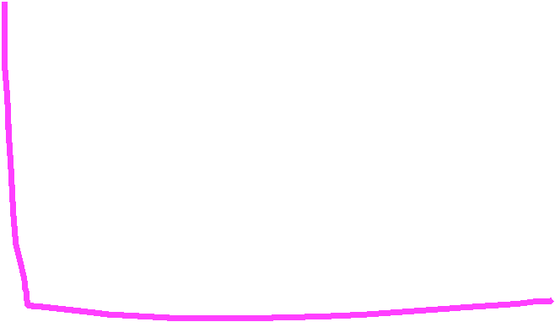


Slide 33































































































In inventory management, economic order quantity is the order quantity that minimizes the total holding costs and ordering costs.

Slide 34






















































Buffer Stock or Safety Stock

Slide 35
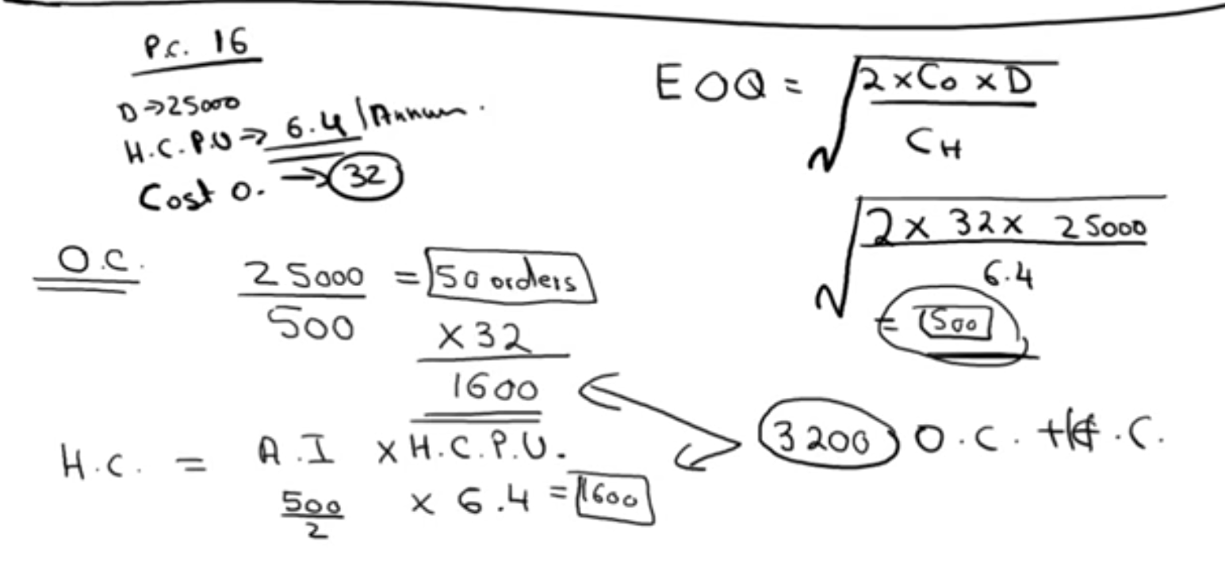


































A company purchase a raw material with purchasing cost is 16 rps, company whole year requirement or demand is 25000 units. Holding cost per unit is 6.4 per year, cost of ordering is 32 Rps. Calculate the EOQ

Slide 36
